Slide 1
Unit 4
Three-Dimensional Geometric Transformation

Slide 2
Introduction
3D computer graphics or three dimensional computer graphics are graphics that use a three- dimensional representation of geometric data that is stored in the computer for the purpose of performing calculations and rendering 2D images.
2D is “flat” using the horizontal and vertical (X & Y) dimensions, the image has only two dimensions. 3D adds the depth (Z) dimension. This third dimension allows for rotation and visualization from multiple perspectives.
We can perform different transformation by specifying the three dimensional transformation vector, however the 3D transformation is more complex than 2D transformation.

Slide 3
What are the issue in 3D that makes it more complex than 2D?
When we model and display a three-dimensional scene, there are many more
considerations we must take into account besides just including coordinate value as 2D, some of them are:
Relatively more coordinates point are necessary.
Object boundaries can be constructed with various combinations of plane and curved surfaces.
Consideration of projection (dimension change with distance) and transparency.
Many consideration on visible surface detection and remove the hidden surfaces.

Slide 4
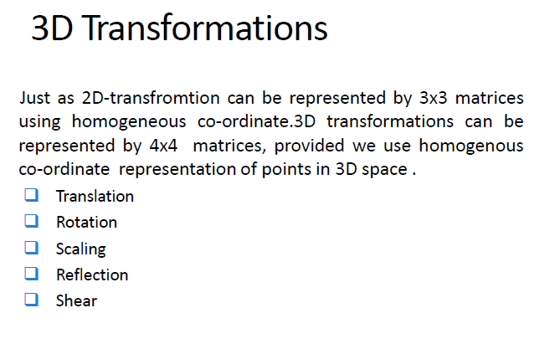

Slide 5
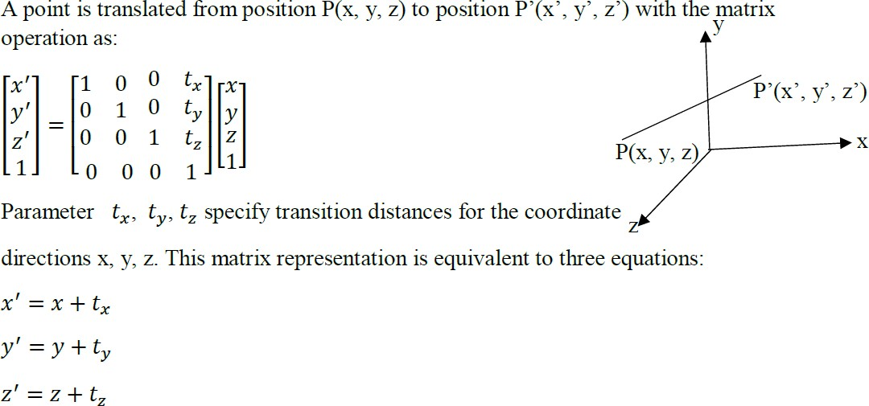
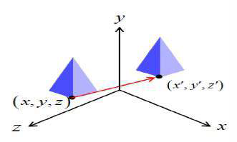
3D Translation

Slide 6
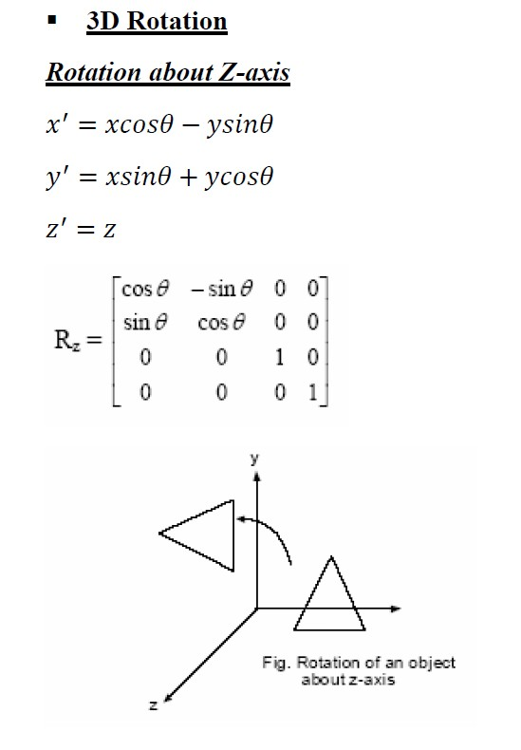
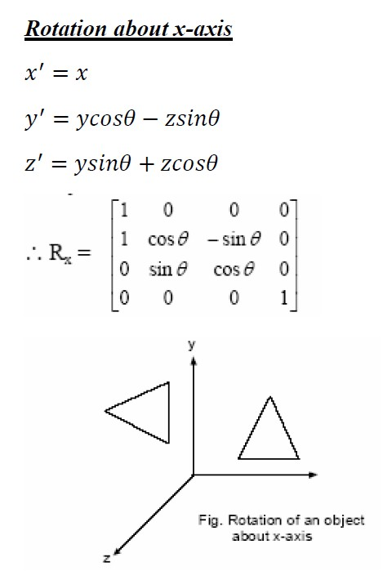
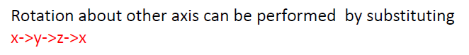
60

Slide 7
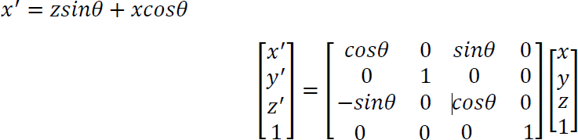
Rotation about y-axis
𝑦′ = 𝑦
𝑧′ = 𝑧𝑐𝑜𝑠𝜃 − 𝑥𝑠𝑖𝑛𝜃
General 3D rotation (Rotation about any coordinate axis)
Parallel to any of the co-ordinate axis:
When an object is to be rotated about an axis that is parallel to one of the co-ordinate axis,
we need to perform some series of transformation.
Translate the object so that the rotation axis coincides with the parallel co-ordinate axis.
T(-a,-b,-c) where, (a, b, c) is any point on the rotation axis.
Performed the specified rotation about the axis. R_{x}(θ )
Translate the object so that the rotation axis is moved to its original position. T(a, b, c).
Net transformation= T(a, b, c) R_{x}(θ). T(-a,-b,-c)

Slide 8
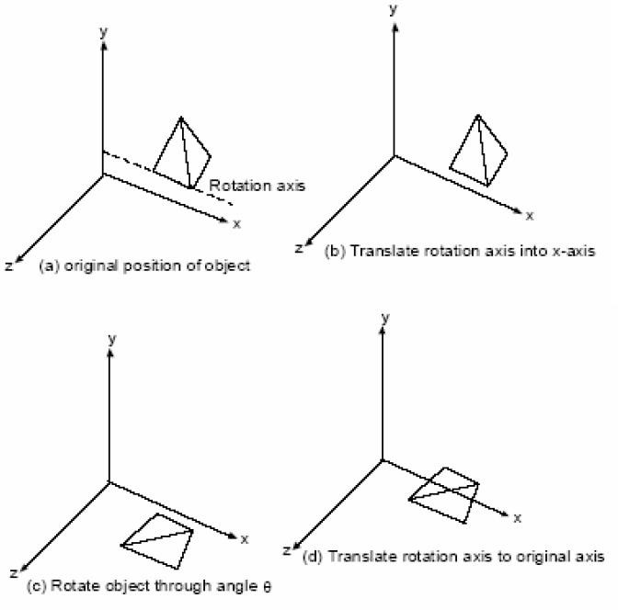

Slide 9
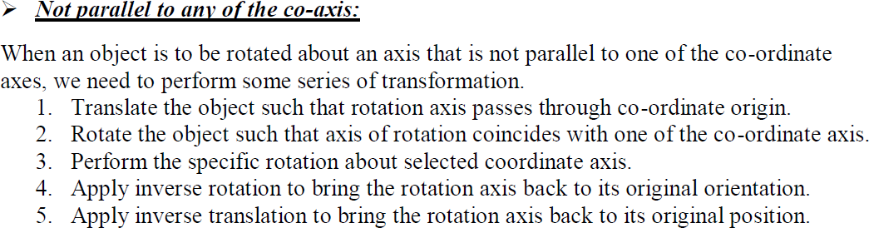

Slide 10
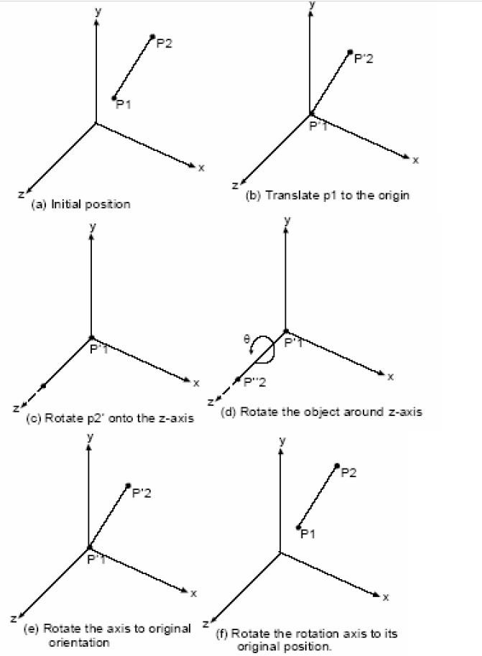

Slide 11
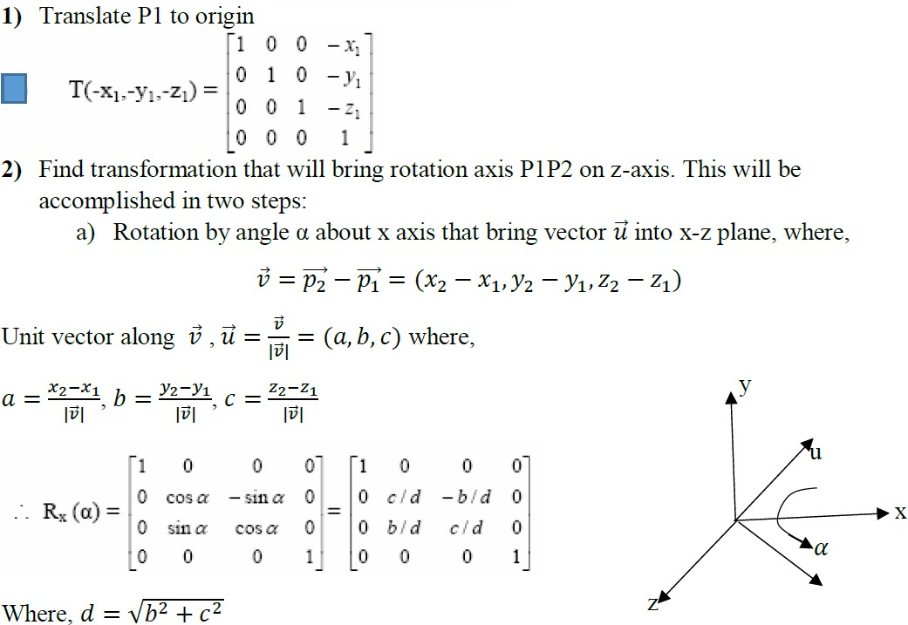


Slide 12
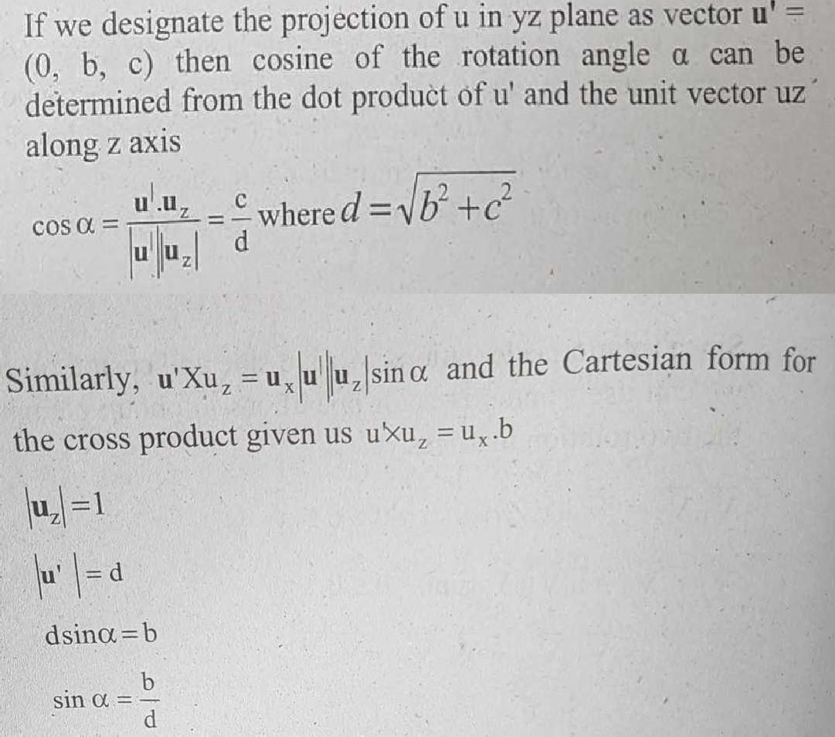

Slide 13

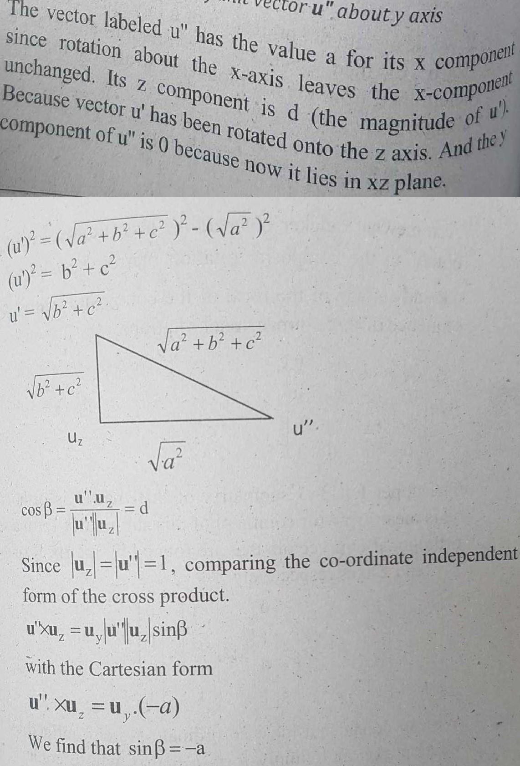

Slide 14
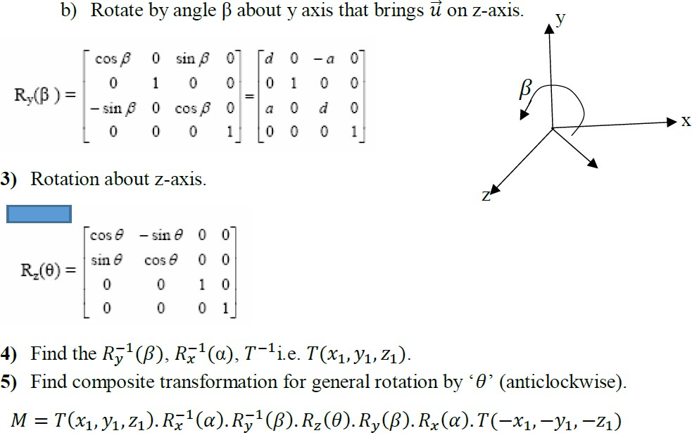

Slide 15
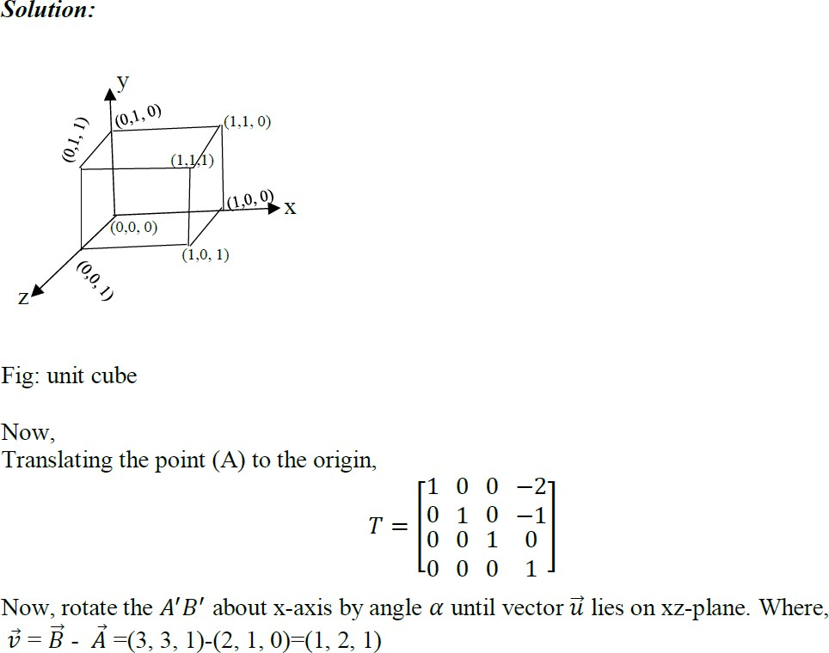
Q. Find the new co-ordinates of a unit cube 90 degree rotated about an axis defined by its end points A(2, 1, 0) and B(3, 3, 1).

Slide 16
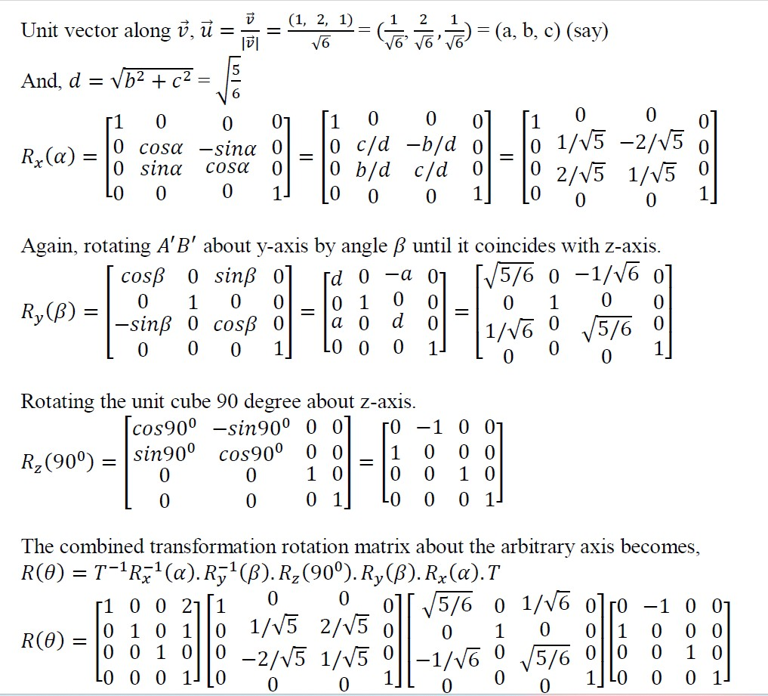

Slide 17
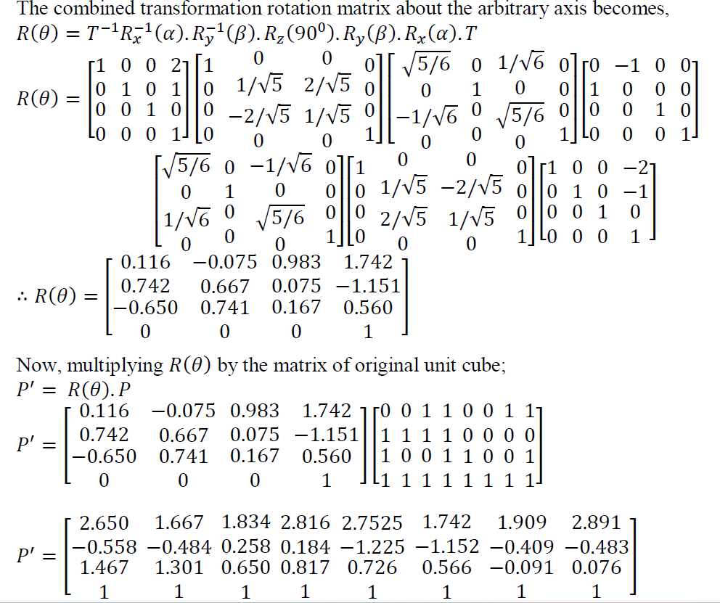

Slide 18
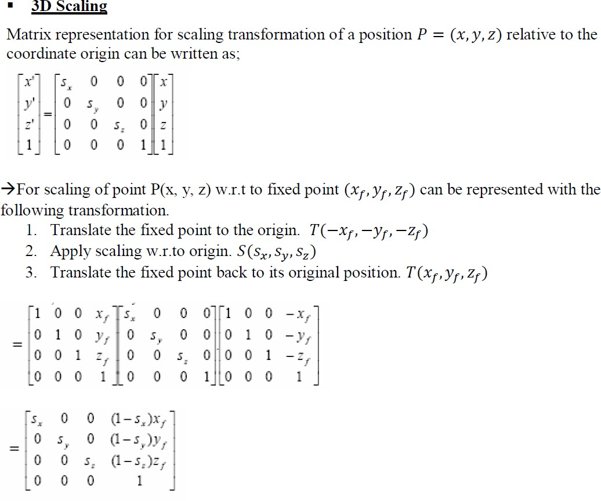

Slide 19
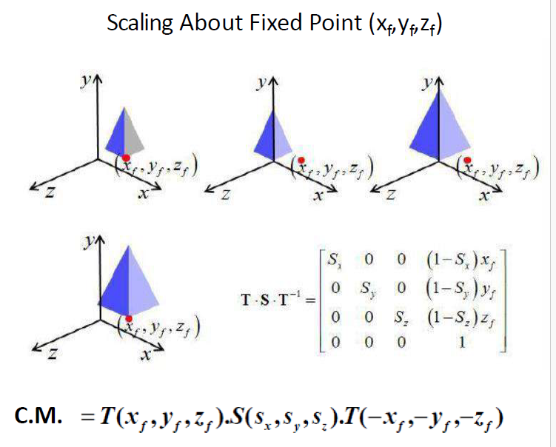

Slide 20
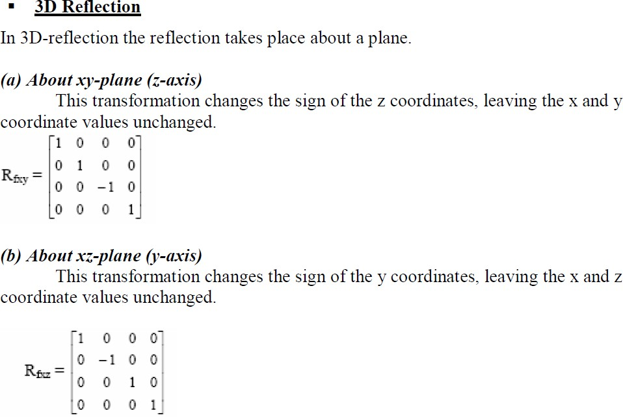

Slide 21
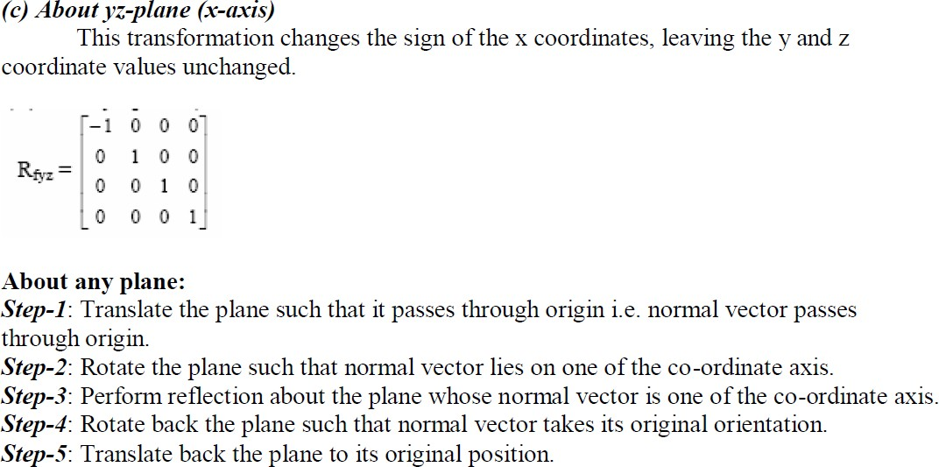

Slide 22
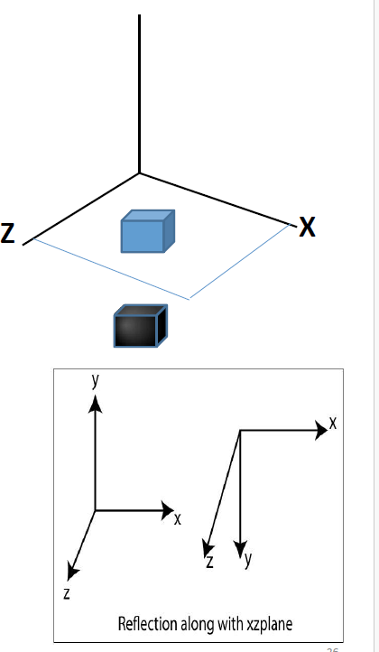
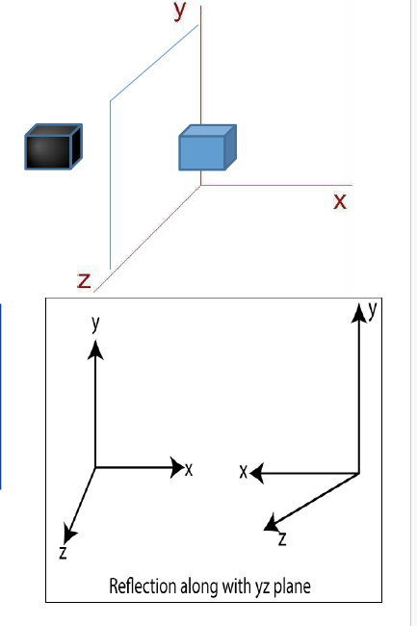
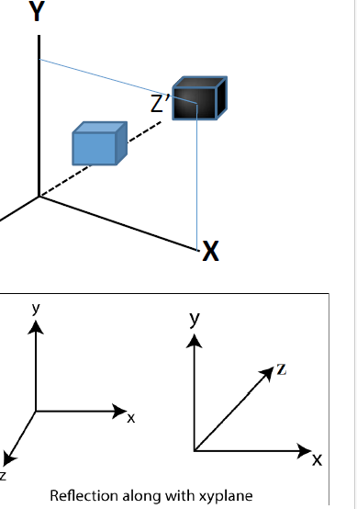

Slide 23
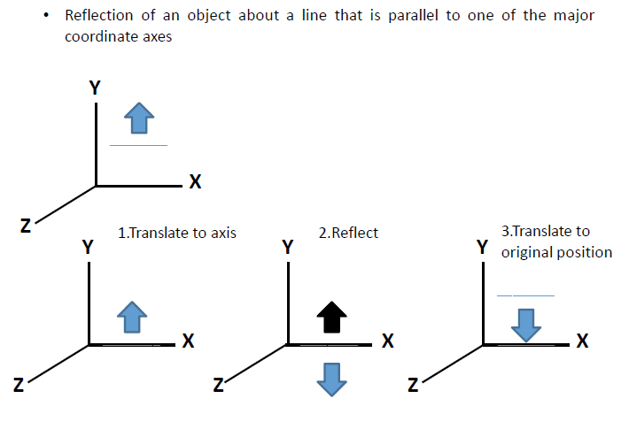

Slide 24
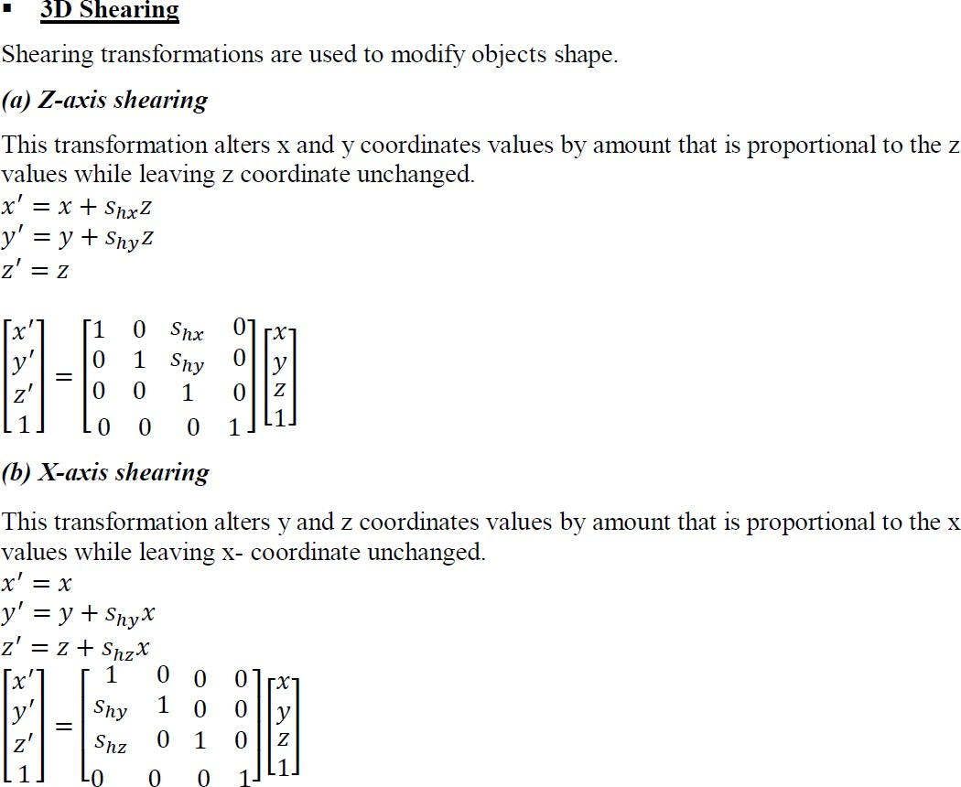

Slide 25
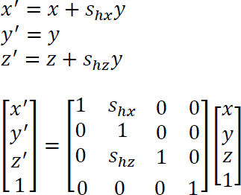
(c) Y- axis shearing
This transformation alters x and z coordinates values by amount that is proportional to the y values while leaving y- coordinate unchanged.

Slide 26
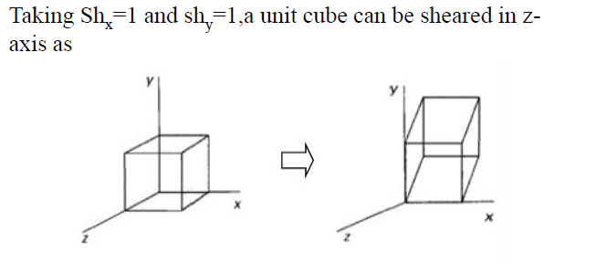

Slide 27
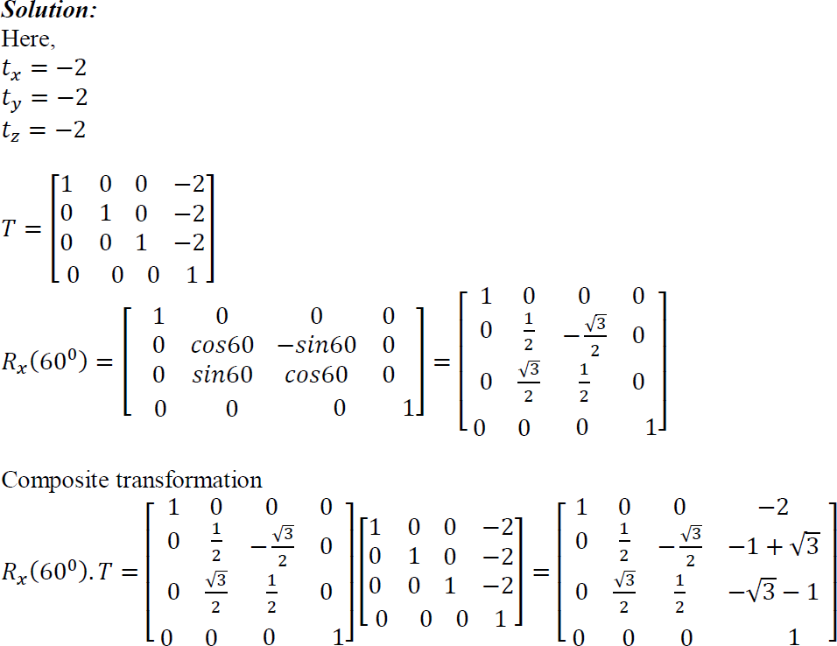
Q. A homogenous coordinate point P(3, 2, 1) is translated in x, y, z direction by -2, -2 & -2 unit respectively followed by successive rotation of 60⁰ about x- axis. Find the final position of homogenous coordinate.

Slide 28
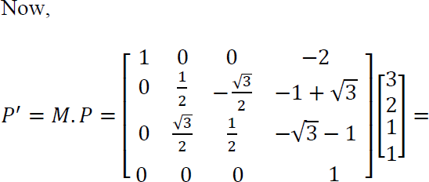

Slide 29
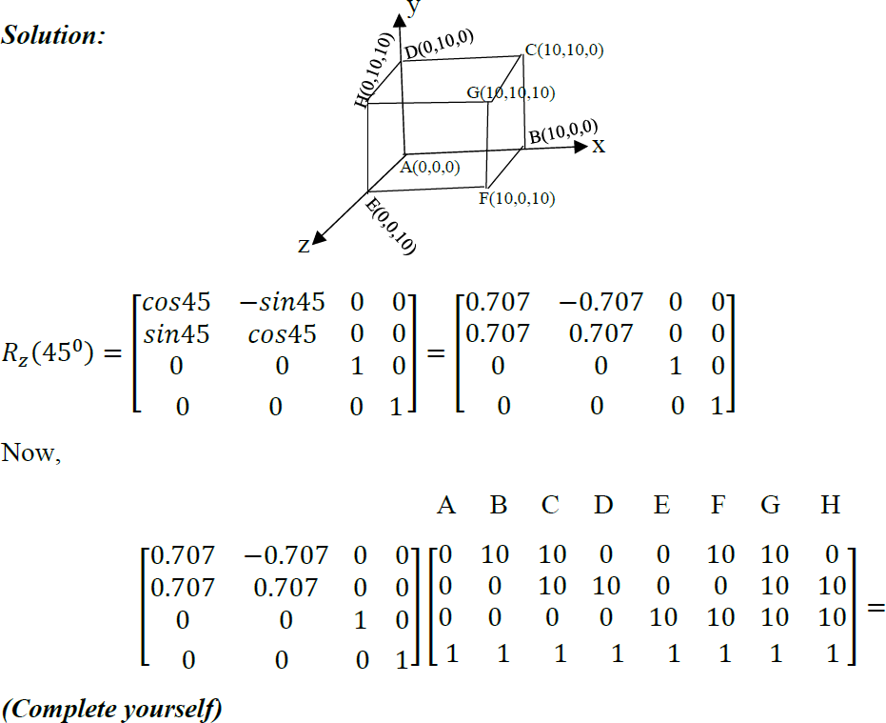
Q. A cube of length 10 units having one of its corner at origin (0, 0, 0) & three edges along principal axis. If the cube is to be rotated about z-axis by an angle of 45⁰ in counter clockwise direction, calculate the new position of point.

Slide 30
3D Viewing
In 3D viewing, we specify a view volume in the world, a projection onto a projection plane, and a viewport on the view surface. Conceptually, objects in 3D world are clipped against the 3D view volume and are then projected. The contents of the projection of the view volume onto the projection plane, called the window, are then transformed (mapped) into the viewport for display.
Viewing in 3D involves the following considerations:
We can view an object from any spatial position. E.g. In front of an object, Behind the object, In the middle of a group of the objects, Inside an object.
3D descriptions of objects must be projected onto the flat viewing surface of the output device.
The clipping boundaries enclose a volume of space.

Slide 31
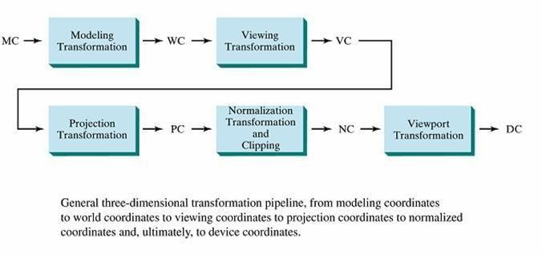
3D Viewing Pipeline

Slide 32
Modeling transformation and viewing transformation can be done by 3D transformations. The viewing- coordinate system is used in graphics package as a reference for specifying the observer viewing position and the position of the projection plane. Projection operations convert the viewing-coordinate description (3D) to coordinate position on the projection plane (2D). (Usually combined with clipping, visual-surface identification, and surface rendering). Normalization transformation & clipping and view port transformation maps the coordinate positions on the projection plane to the output device.
Projection
Projection is any method of mapping three dimensional (3D) objects into two dimensional (2D) view plane
(screen). In general, projection transforms a N-dimension points to N-1 dimensions.
Two types of projection:
Parallel projection:
In parallel projection, coordinate positions are transformed to view plane along parallel line.
A parallel projection preserves relative proportion of objects so that accurate views of various sides of an object are obtained but doesn’t give realistic representation of the 3D objects.
Can be used for exact measurement so parallel lines remain parallel.

Slide 33
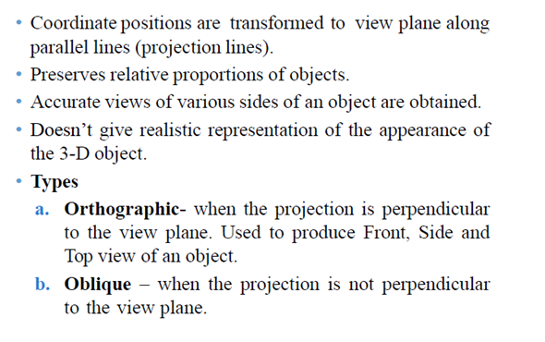
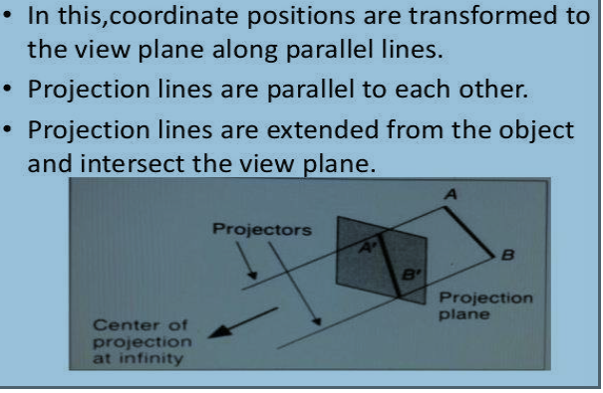

Slide 34
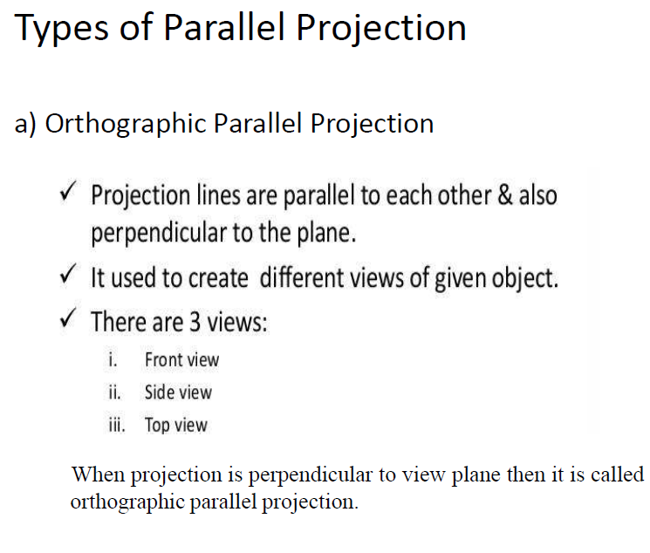
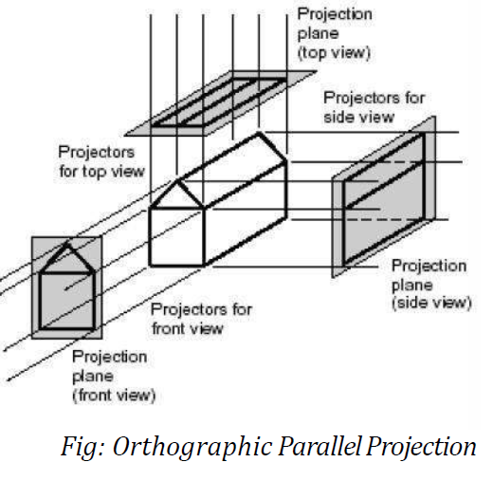

Slide 35
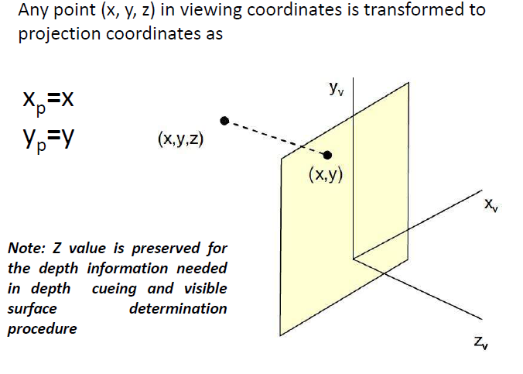

Slide 36
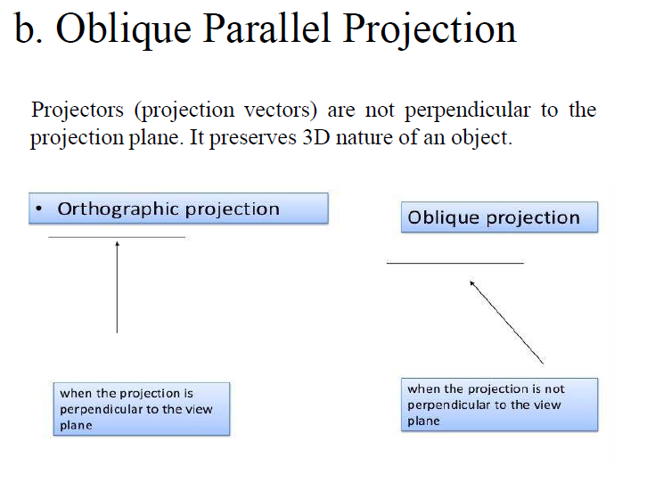

Slide 37
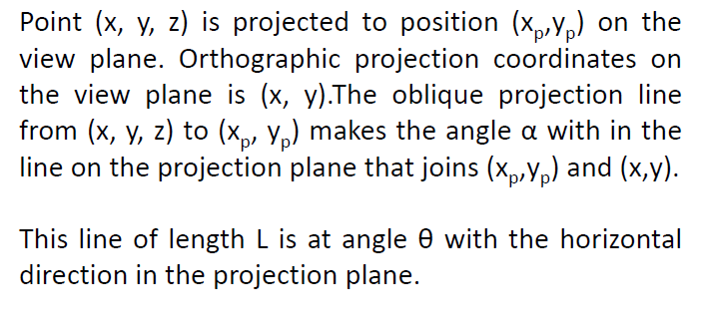
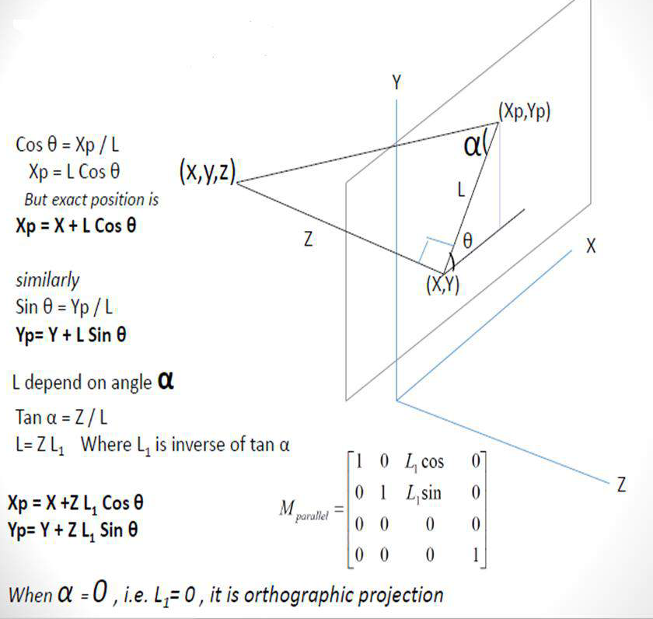

Slide 38
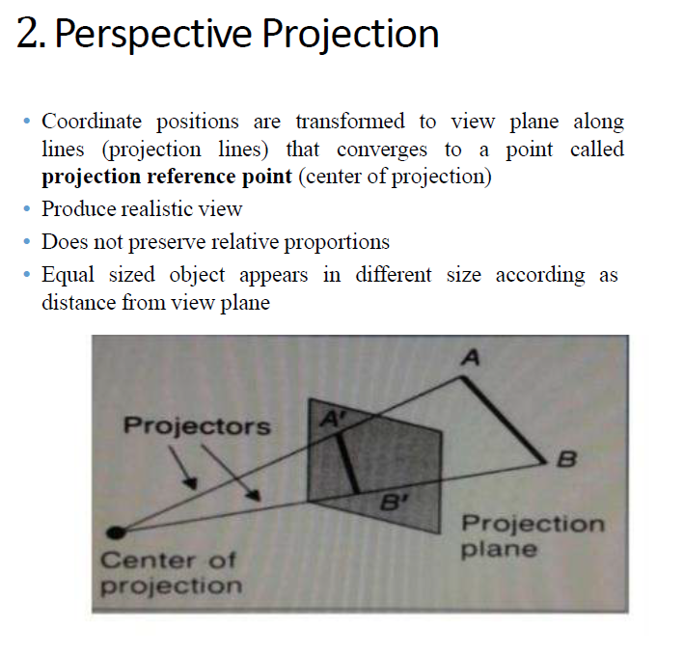

Slide 39
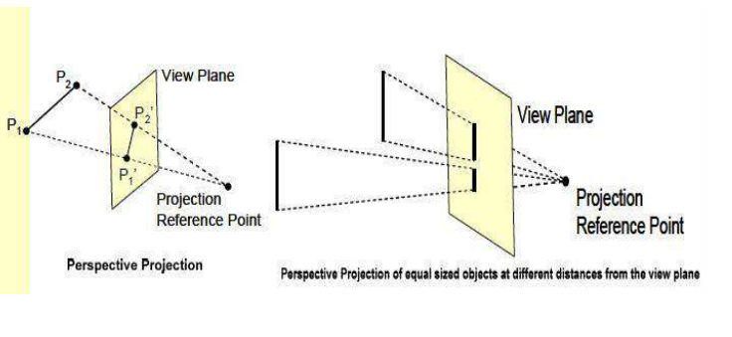

Slide 40
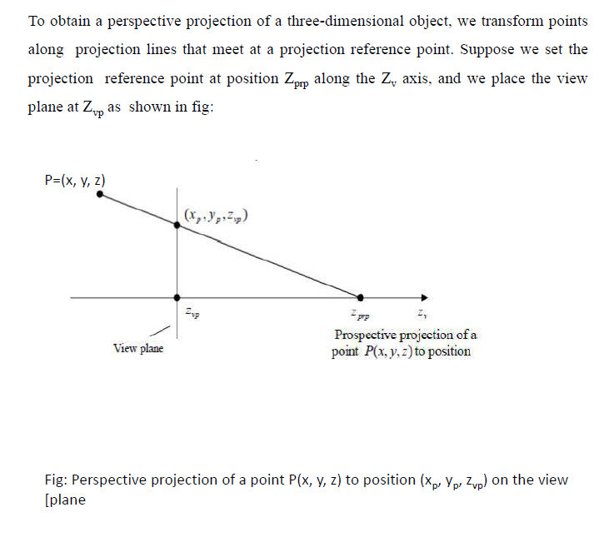

Slide 41
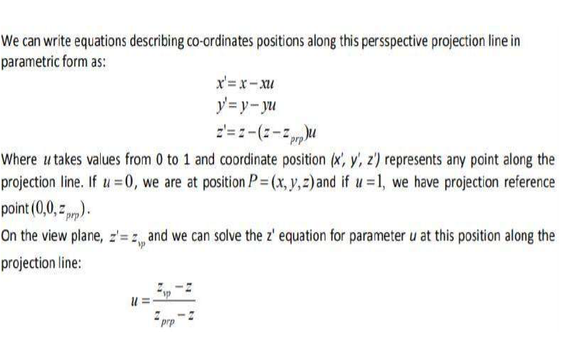

Slide 42
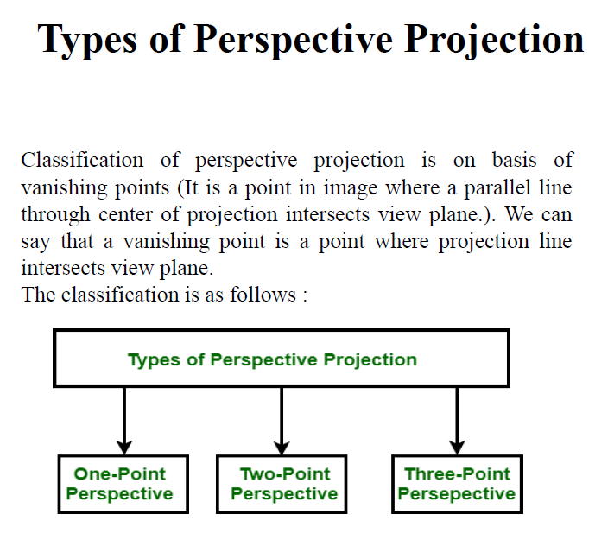
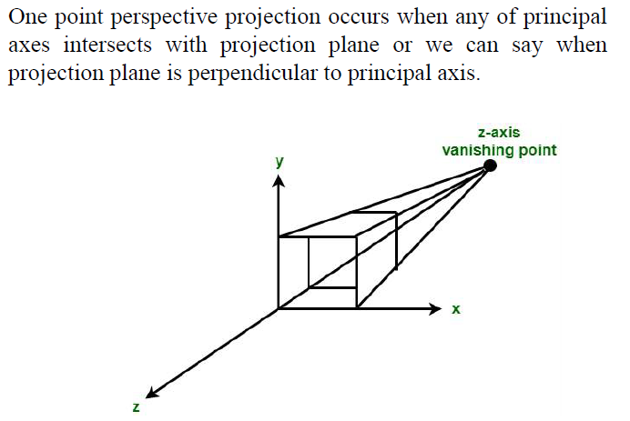
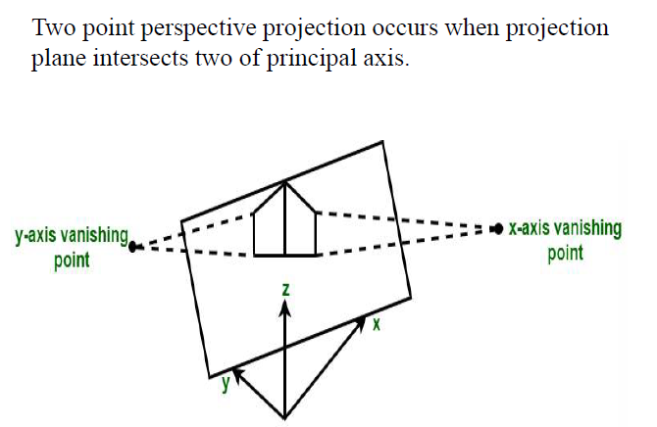

Slide 43
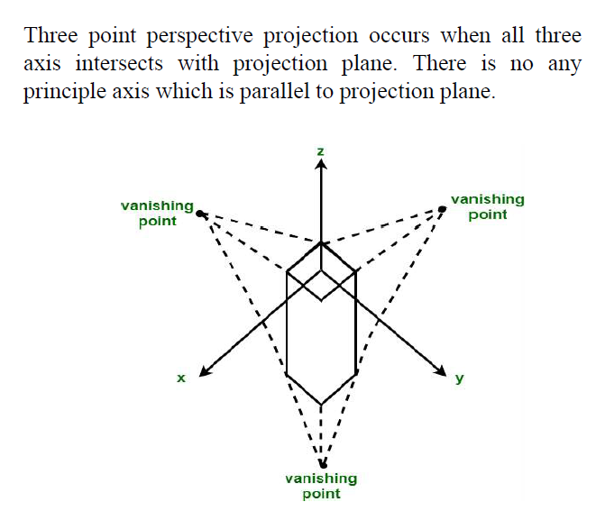
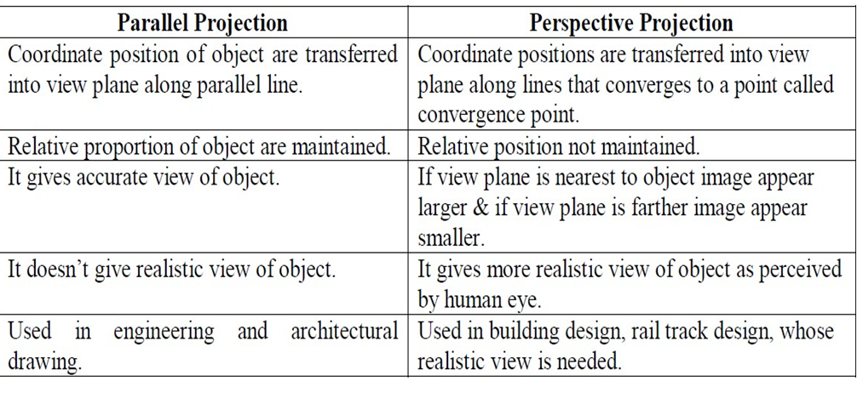

Slide 44
